Slide 1
Identifying Contrails to Reduce Global Warming [ICRGW]
Swaroop Meher

Slide 2
AGENDA
Introduction
Primary goals
Dataset
Preprocessing
Model
Results
Challenges faced
Areas of growth
Summary

Slide 3

INTRODUCTION
Contrails are clouds of ice crystals that form in aircraft engine exhaust.
Trap heat within the Earth's atmosphere.
Contrails contribute approximately 1% of all human caused global warming.
Identifying them will help airlines avoid creating contrails and reduce their impact on climate change.

Slide 4

What can we do?
Researchers have created models that can predict the occurrence of contrails and estimate the extent to which they contribute to warming.
In order to validate these models, the researchers require satellite imagery.
Google Research team has hosted a competition on Kaggle to get the best models.

Slide 5
PRIMARY GOALS

Slide 6
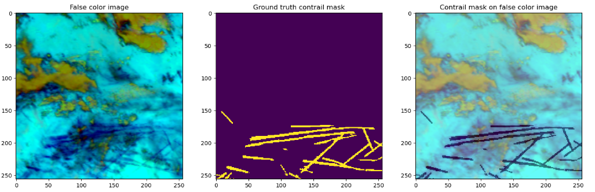
Primary goals
Take satellite imagery and segment the contrails if there are any.
Achieve a dice coefficient greater than 0.6
Tricky part is not every tiny cloud is a contrail.
Contrails must be at least 3x longer than they are wide
Contrails must either appear suddenly or enter from the sides of the image

Slide 7
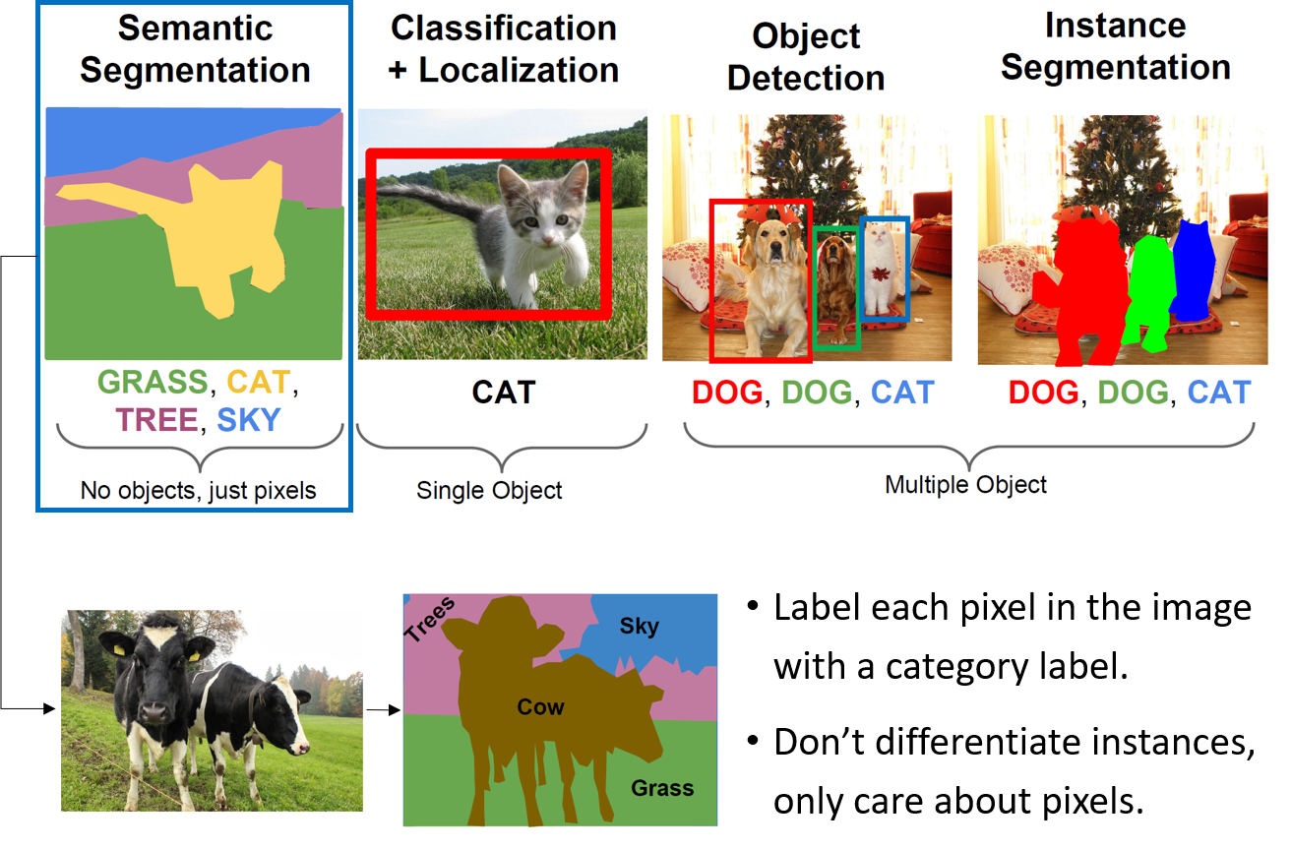
SEMANTIC SEGMENTATION

Slide 8
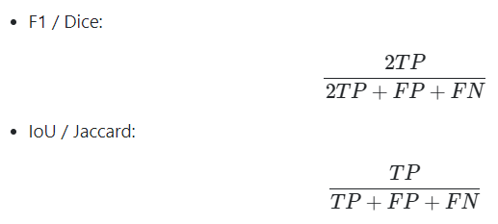
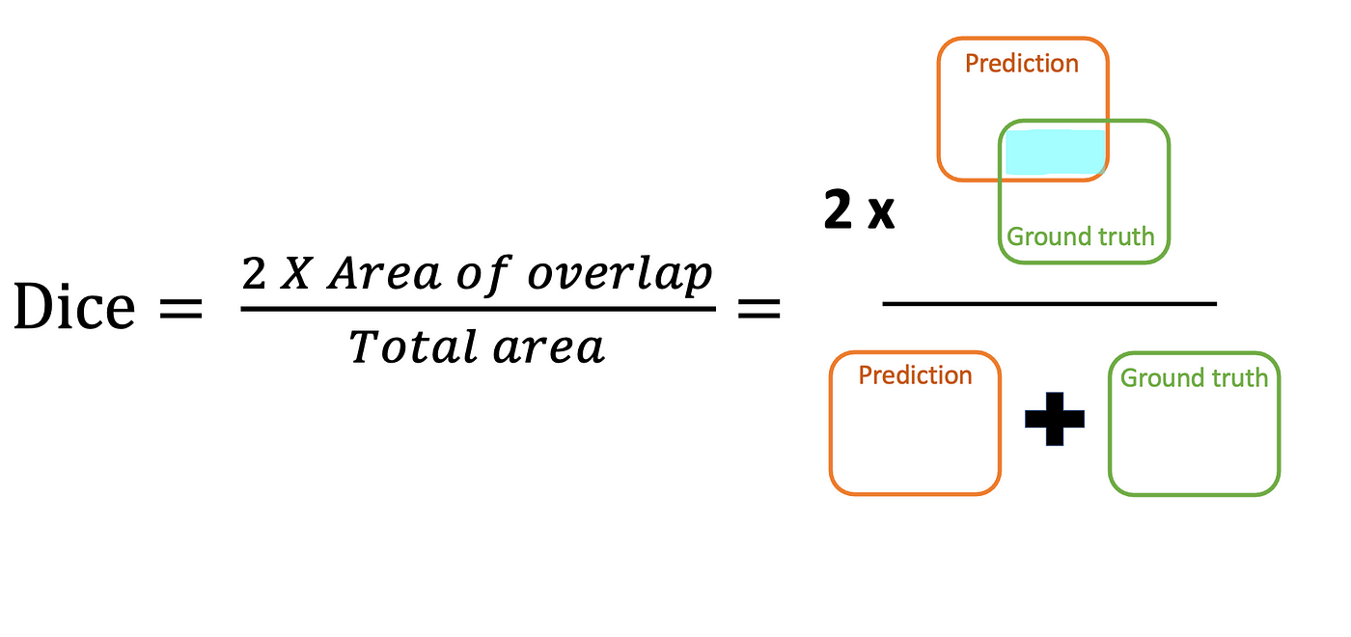
Dice coefficient

Slide 9
dataset

Slide 10

dataset
Satellite images taken by NASA’s GOES-16 Advanced Baseline Imager
Paper: “OpenContrails: Benchmarking Contrail Detection on GOES-16 ABI”
Ground truth was determined by (generally) 4+ different labelers annotating each image.
20.5k train records, 18k val records, and 18k test records (private)

Slide 11
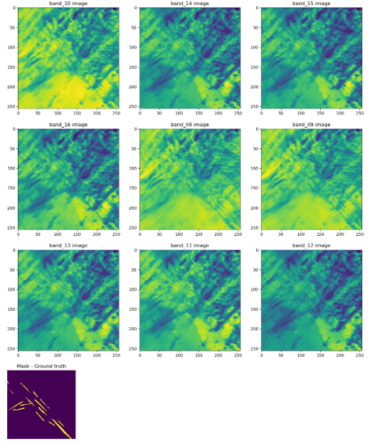
dataset
Each record
9 images of different bands
Each band has 8 frames
Each frame is 10 mins apart
Ground truth – single frame

Slide 12
PREPROCESSING

Slide 13
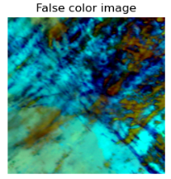
PREPROCESSING
5th frame
9 bands (8-16)
8 frames
RGB – b11, b14, b15
(256,256,3)

Slide 14
PREPROCESSING
DEDUP
PHASH
(N, 256, 256, 3)
(N-X, 256, 256, 3)
AUGMENTATION
RANDOM HFLIP
RANDOM ROTATION
RESIZE
(N-X+Y, 256*S, 256*S, 3)

Slide 15
model

Slide 16
model
UNet Architecture
Backbones:
Efficientnetb3
Efficientnetb5
Efficientnetb7 (best model)
Resnet50
InceptionV3
SE - Resnext101
Pretrained on Imagenet dataset

Slide 17
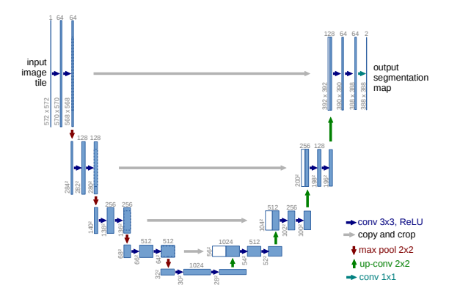
model

Slide 18
model
Hyperparameters:
LR – 0.01, 0.001, 0.03
LR schedulers:
ReduceLRonPlateau
Polynomial Decay
Cosine Decay
Cosine Annealing
Exponential Decay
Epochs – 20, 50, 100
Callbacks:
ModelCheckpoint
EarlyStopping
Learning Scheduler
Loss – Dice loss
Optimizer - Adam

Slide 19
Results

Slide 20
Results
Model | Val DICE score | Test DICE score
EfficientnetB7 | 0.60 | 0.62
EfficientnetB3 | 0.55 | 0.58
InceptionV3 | 0.53 | 0.55

Slide 21
CHALLENGES FACED

Slide 22
CHALLENGES FACED
Handling a huge dataset – 450GB.
Lack of prebuilt segmentation packages with the latest architecture in TensorFlow.
Limited usage of GPU and TPU.
Frequent crashes due OOM errors.

Slide 23
AREAS OF GROWTH
​ | CATEGORY 1 | CATEGORY 2 | CATEGORY 3​ | CATEGORY 4​
Q1 | 4.5​ | 2.3​ | 1.7​ | 5​.0
Q2 | 3.2​ | 5.1​ | 4.4​ | 3​.0
Q3 | 2.1​ | 1.7​ | 2.5​ | 2.8​
Q4 | 4.5​ | 2.2​ | 1.7​ | 7.0

Slide 24
AREAS OF GROWTH

Slide 25
AREAS OF GROWTH
Gather more data
Try Lovasz-hinge loss and focal_tversky_loss
Try a 2 model structure – Classification model + segmentation model
Random resize and crop
Try ResNeSt – uses split attention
Try Visual transformers – visual attention
Resize the image to 1024*1024

Slide 26
SUMMARY
Finally, I would like to conclude by saying that the project "Identifying Contrails to Reduce Global Warming" developed a machine learning pipeline, utilizing efficientnetb7, to segment satellite images for contrails. The best model achieved a high dice score of 0.62 on the test data, promising significant contributions in understanding and mitigating the impact of contrails on global warming.

Slide 27
THANK YOU
Swaroop Meher

